Slide 1

Path Traversal and Web Cache Poisoning
Assignment Group 25

Slide 2

Group Members and Primary Responsibilities
Member | Primary Responsibilities | Estimated effort
Isuru | Vulnerable code and exploit script of Path Traversal Vulnerability, project board setup, timeline management and project management. | 25%
Manodya | Vulnerable code and exploit script of Web Cache Poisoning, Report structure and consolidation. | 25%
Sasmitha | Mitigated code for Path Traversal, Mitigated code for Web Cache Poisoning. | 25%
Theekshana | Detection and Tracing of Path Traversal and Web Cache Poisoning, Verification of the mitigated code. | 25%

Slide 3
Project timeline and Tools used
Set-Up and Research
23 August - 25 August
Category | Tool Used
Project management and Version control | GitHub
Meeting tracking | Toggl
Communication | Discord / WhatsApp
Logging / evidence capture | Python logging, server access logs
Development of the Vulnerable codes
26 August - 17 September
Development of the Exploit codes
17 September - 18 September
Detection and Tracing
18 September - 22 September
Creating the mitigation codes
22 September - 25 September
Creating the report and presentation
25 September - 06 October
Review and submission
06 October - 08 October

Slide 4

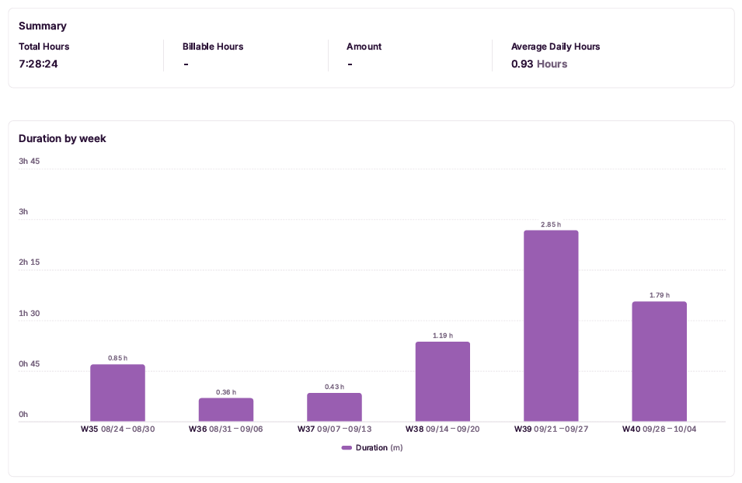
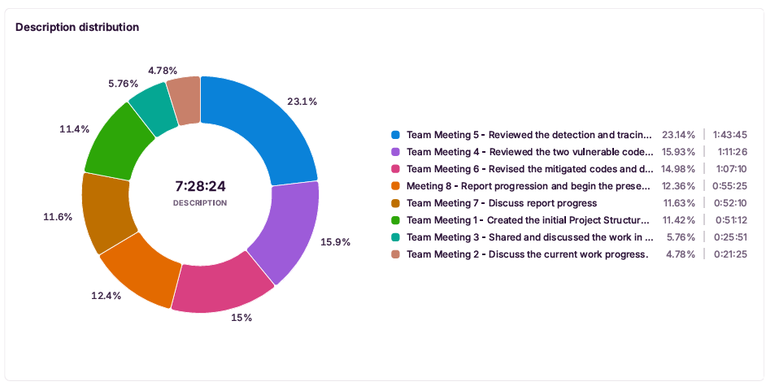
Meetings

Slide 5
Evidence of Version Control
 | Date | Commits | Member committed | Evidence
1 | 25 August | Initial commit | Isuru | 72af218c0895289395fe81b471b88b9a42c4de18
2 | 25 August | Created the Initial folder Structure | Isuru | 175153863f37e7a143d70d9a73a595a12a335318
3 | 16 September | Add Path Traversal vulnerability app and welcome.txt | Isuru | c9e02a144134e96f5b3b03e5358811bcb21c6312
4 | 16 September | Created the vulnerable app code | Manodya | 55822847c58ef9fb6d3dce11dc119eed16f732e6
5 | 17 September | Added Path Traversal exploit script | Isuru | c4511121f8225105660b8f97c8bc5646b954c5ce
6 | 18 September | Created the exploit code | Manodya | 920c0ec5caa30c56f8824df2bf98f93208ea305b
7 | 21 September | Added Path Traversal README file | Isuru | 412fe61eafb63c9c993ffeef6067cb01282ad2f8
8 | 21 September | Added detection and tracing scripts and Readme for Web Cache Poisoning and Path Traversal | Theeksahna | 066f87d002b18c9db54bbeae5621309e43f35cd8
9 | 21 September | Created a README file for Web Cache Poisoning | Manodya | 1dd76336a800ae46535d4504be8aef01726114ce
10 | 24 September | Created the mitigated code for path traversal | Sasmitha | a979ee97f13b38af0f304e33d081e3fc903c3d1b
11 | 24 September | Update the exploit.py code | Isuru | eed5a2ec56a8b6f00f9cae682b5e7b0207396711
12 | 25 September | Update both the path traversal and web cache poisoning README file | Sasmitha | cf36407816c5dc85d373d6ad8a01de6c573a9987

Slide 6
Two Vulnerabilities
Modern web applications face growing security threats as complexity increases. Minor development errors — insufficient input validation, misconfigured caching — create significant avenues for exploitation.
Path Traversal
Web Cache Poisoning
Occurs when an application allows user-supplied input to dictate a file-system path without proper sanitisation, enabling access to restricted files outside the intended operational scope. Classified as CWE-22.
Occurs when a caching layer serves stored responses based on a flawed understanding of what makes a request unique — allowing a single manipulated request to corrupt the cache and serve malicious content to all subsequent users.

Slide 7

Vulnerability 1: Path Traversal

Slide 8
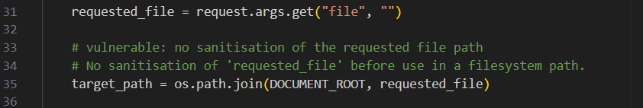
Vulnerable Code
A Flask “Document Portal” app serves files via /download?file=<name>, intended to restrict access to app_files/.
Root Cause of the Vulnerability
os.path.join() does not block “../” sequences. Although the base path is DOCUMENT_ROOT, the target path is never checked to confirm it still resolves inside that directory.
Test File
Secret_config.txt
Sensitive file that is not supposed to be reachable by the app
welcome.txt
Legitimate file that can be access through the app

Slide 9
What is Path Traversal and Why It Matters
Path traversal (CWE-22) occurs when a web application takes user input and uses it to build a file-system path without validation. Sequences like “../” move the OS up a directory level, letting attackers reach files outside the intended scope.
Why it's Common and Significant
1
2
3
4
Higher possibility of this vulnerability occurring
Use of language or framework
High impact
Common in real-world systems

Slide 10
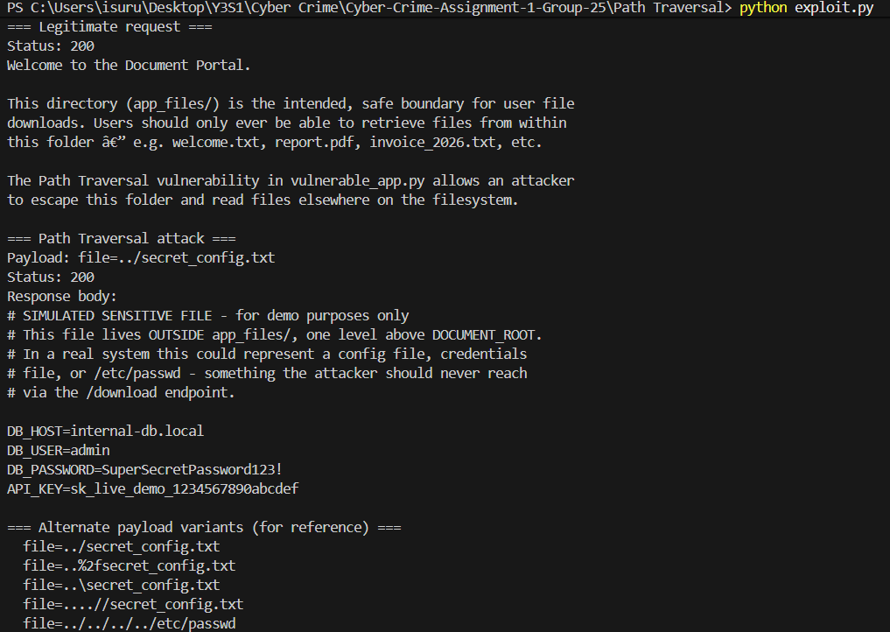
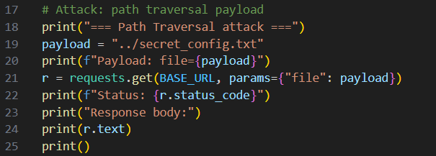
Exploitation Code
exploit.py first requests welcome.txt (legitimate), then attacks secret_config.txt using the payload below:
Executing the exploit.py parallel to the vulnerable_app.py it would print the two text file as displayed.

Slide 11
Impact and Consequences
Source codes exposed
Allows attackers to access application files which leads to discoveries of more vulnerabilities.
System files exposed
Might expose passwords or API keys that would allow attackers to access other system files.
Unauthorised external codes executed
Attackers might execute their own codes that would give external control over the server.
Breach of confidentiality
Expose confidential documents that compromises user and system privacy.

Slide 12
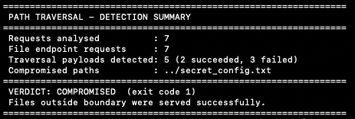
Detection and Tracing
Tool: pt_detector.py, reads the app's own access log (or stdin)
$ python pt_detector.py access.log
Attack log: COMPROMISED (exit 1)
2 traversal requests succeeded, 3 failed
Clean log: CLEAN (exit 0)
1
Capture
Every /download?file= request is already in the app's access log: IP, URL, status code.
2
Capture
Every /download?file= request is already in the app's access log: IP, URL, status code.
3
Capture
Every /download?file= request is already in the app's access log: IP, URL, status code.

Slide 13
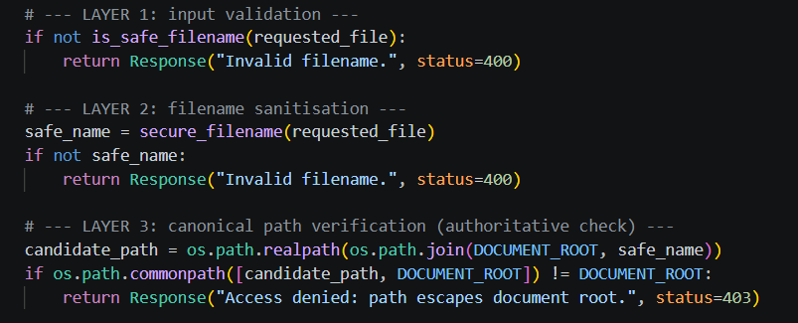
Mitigation Code
1. Input Validation
Rejects unsafe filenames such as .., /, \, empty names and absolute paths.
2. Filename Sanitisation
secure_filename() cleans the filename before it is used.
3. Path Verification
realpath() finds the actual file location.
commonpath() makes sure the file stays inside DOCUMENT_ROOT.

Slide 14
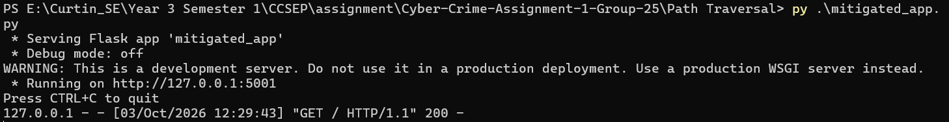
Running the Mitigated Code
Run the application using:
python .\app_mitigated.py
Flask starts on:
http://127.0.0.1:5001
Debug mode is disabled.
Test the /download endpoint with a valid file such as welcome.txt.
Invalid or malicious filenames are rejected.

Slide 15
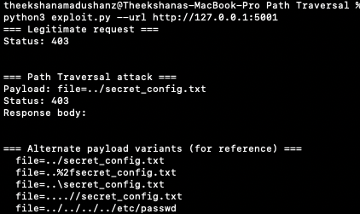
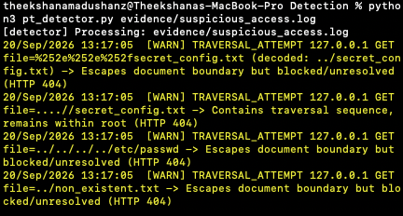
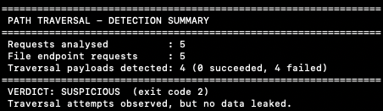
Verification of Mitigation
Same exploit, same detector, run against the vulnerable app (5000) and
the mitigated app (5001)​
Test | Vulnerable app | Mitigated app
file=welcome.txt (legitimate) | 200, file served | 200, file served
file=../secret_config.txt (exploit) | 200, DB credentials leaked | 400 Invalid filename
Variants: ..%2f, ..\, ....//, absolute path | Some succeed, some fail | Rejected (400 / 403)
pt_detector.py verdict | COMPROMISED (exit 1) | No TRAVERSAL_SUCCESS, attempts only

Slide 16


Vulnerability 2:
WEB CACHE POISONING

Slide 17
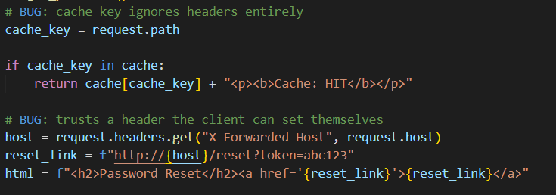
Vulnerable Code
A Flask password-reset page uses an in-memory cache to store responses for /forgot-password.
Root Cause of the Vulnerability
The key uses only the path. The header changes the link. The app caches that link and reuses it for later requests.
Code Weakness
No header validation
Incomplete Cache Key
The header sets the host without checks.
Different headers share one cache entry.

Slide 18
What is Web Cache Poisoning and Why It Matters
Web Cache Poisoning occurs when an attacker manipulates a response that a shared cache stores and serves to other users. In our app, X-Forwarded-Host changes the reset link while the cache key remains the same.
Why it's Common and Significant
1
Untrusted input changes the content
2
Incomplete Cache Keys
3
Poisonous content reaches the users
4
Phishing risk and loss of trust

Slide 19
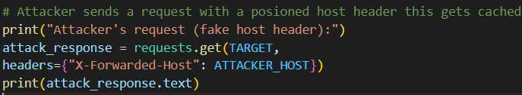
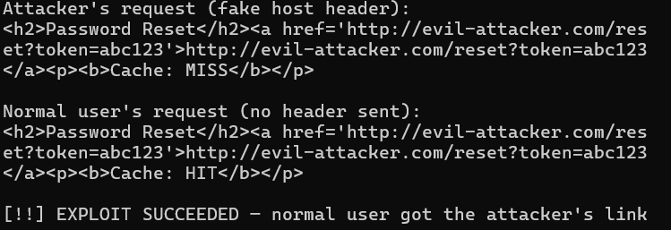
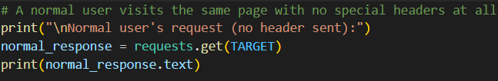
Exploitation Code
exploit.py clears the cache, sends a fake forwarded host, then requests the same page without that header.
Step 1: Attacker sends a poisoned header request
Expected output
Step 2: Request as a normal user
Finally normal user receive the attacker’s link because it is already stored in the cache, even though they did not send a fake header.

Slide 20
Impact and Consequences
1
Poisoned Responses
A normal request receives a cached reset link pointing to the attacker’s host.
2
Phishing Risk
A user who follows the misleading link could reach a malicious destination.
3
Wider exposure
The same poisoned entry may affect later requests until the cache is cleared.
4
Loss of trust
Malicious links presented by trusted service can damage user confidence.

Slide 21
Detection and Tracing
Tools: instrumented_run.py + wcp_detector.py (app runs unchanged, one JSON log line per request)
Attack trace
1.
Instrument
instrumented_run.py wraps the unchanged app and logs path, headers and cache result (MISS / HIT) for every request.
Attacker​
X-Forwarded-Host: evil-attacker.com​
MISS, SPOOF_HEADER +POISON_WRITE​
2.
Detect
2
SPOOF_HEADER: X-Forwarded-Host sent. POISON_WRITE: spoofed response stored in the cache. POISONED_HIT: a clean request served the spoofed content.
Cache​
/forgot-password stored with evil link​
key = path only​
3.
Verdict
CLEAN (0), SUSPICIOUS (2), COMPROMISED (1). --follow mode watches the log live.
Normal user​
No special header​
HIT, POISONED_HIT​

Slide 22
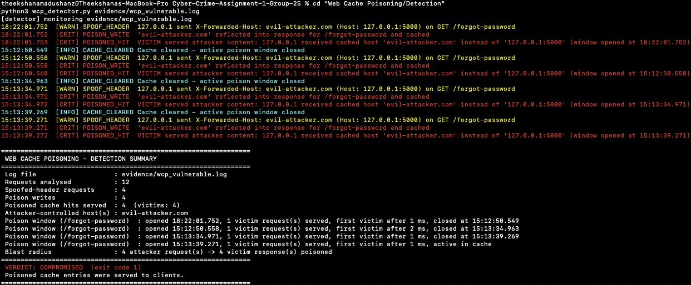
Detection and Tracing
wcp_detector.py verdict on the vulnerable run​

Slide 23
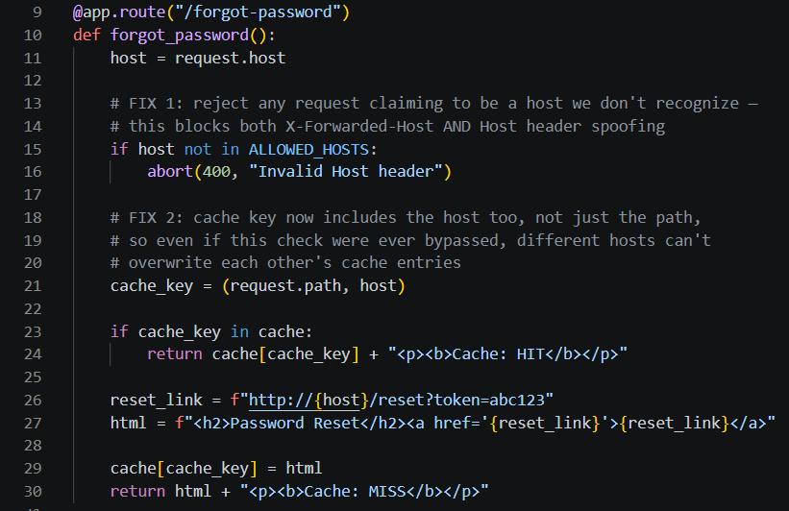
Mitigation Code
1. Host Validation
Checks request.host against the ALLOWED_HOSTS list.
Rejects any untrusted host.
Prevents attackers from changing the Host header.
2. Cache Key Protection
Uses (request.path, host) as the cache key.
Keeps cache entries for different hosts separate.
3. Two Layers of Protection
Host validation blocks untrusted hosts.
The host-based cache key prevents different hosts from sharing cached responses.

Slide 24
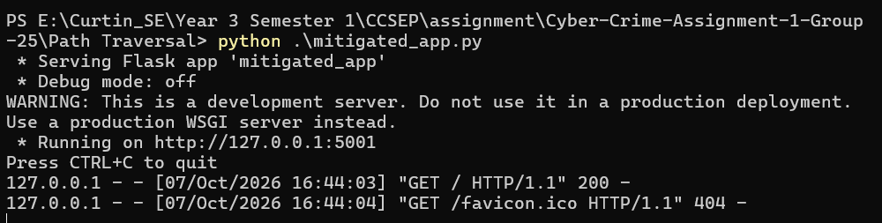
Running the Mitigated Code
Run using:
python .\app_mitigated.py
Flask starts on:
http://127.0.0.1:5000
Test the /forgot-password endpoint.
A 200 status confirms that the endpoint is working correctly.
The application still supports cache hits while keeping different hosts separate.

Slide 25
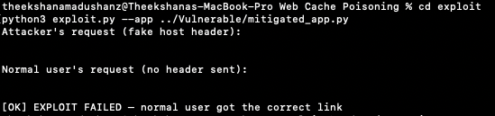
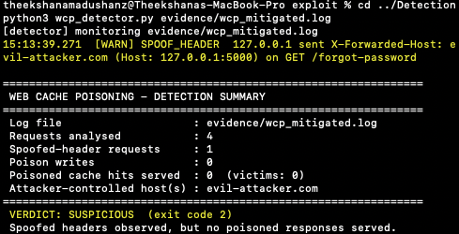
Verification of Mitigation
Same exploit, same detector, run with --app pointing at the mitigated file
exploit.py against the mitigated app
Step | Vulnerable app | Mitigated app
Attacker sends X-Forwarded-Host: evil-attacker.com | Reset link points to evil-attacker.com (MISS) | Header ignored, link uses the real host
Spoofed Host header | Accepted | 400 Invalid Host header
Normal user, no header | HIT, gets attacker's link | HIT, gets the genuine link
exploit.py result | EXPLOIT SUCCEEDED | Does not succeed
wcp_detector.py verdict | COMPROMISED (POISON_WRITE + POISONED_HIT) | No POISON_WRITE or POISONED_HIT
wcp_detector.py on the mitigated run​

Slide 26
Discussion of mitigation Strategies and Security recommendation
DEFENCE IN DEPTH
Both attacks use the same idea: use multiple security checks instead of relying on one check.
For Path Traversal, validate and clean the filename and make sure the final file is inside the allowed folder.
For Web Cache Poisoning, do not trust user-controlled information and make sure important request details are included in the cache key.

Slide 27
SECURITY RECOMMENDATIONS
Do not trust user input when deciding file paths, URLs or cache keys.
Treat caches, proxies and CDNs as part of the security risk.
Use more than one security check so another check can stop an attack if one is bypassed.
Test the original attack again after applying the fix.
Keep useful request details in logs to help identify attacks.

Slide 28
Conclusion
Both vulnerabilities show how unsafe handling of user controlled input can cross an application's security boundaries.
Vulnerability | Demonstrated attack | Mitigation
Path Traversal | Read a test file outside the website’s allowed folder. | Check the filename and make sure the file stays inside the website’s allowed folder.
Web Cache Poisoning | A normal user receives the attacker’s reset link stored in the cache. | Ignore the forwarded host, validate host and include it in the cache key.
The project shows why security belongs in every stage of development. Checking user input and testing fixes help protect the application while keeping it usable.

Slide 29
References
[1] OWSAP Top 10.2021: A01:2021 - Broken Access Control. Available at: https://top10.owasp.org/2021/A01_2021-Broken_Access_Control/
[2] OWASP. WSTG-INPV-17: Testing for Host Header Injection. Available at:
https://owasp.org/www-project-web-security-testing-guide/stable/4- Web_Application_Security_Testing/07-Input_Validation_Testing/17- Testing_for_Host_Header_Injection
[3] SecureFlag Knowledge Base. Web Cache Poisoning. Available at: https://knowledgebase.secureflag.com/vulnerabilities/security_misconfiguration/web_cache_poisoning _vulnerability.html
[4] PortSwigger. Web Cache Poisoning. Available at: https://portswigger.net/websecurity/web-cache-poisoning
[5] PortSwigger. Web Cache Entanglement: Novel Pathways to Poisoning Web Caches. Available at:https://portswigger.net/research/web-cache-entanglement
[6] MITRE EMB3D. Path Traversal Protections. Available at: https://emb3d.mitre.org/mitigations/MID-075.html

Slide 30
Thank you

